Slide 1

Opiate Prescription Overdoses CSP/MATH 571 DATA PREPARATION AND ANALYSIS
Roy SUBHADEEP
BOTHARA SHUBHAM

Slide 2
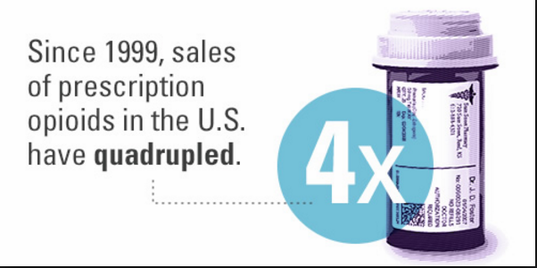
Problem Statement
Motivation:
Overdose fatalities is a well-known problem across US
Active area of research
Scope of analysis:
Detecting primary sources of opiate prescriptions.
Statistical findings on demography.
Detection of important drugs and prescribers.
Examine overdose deaths in race and age groups.

Slide 3
Data Extraction
Data Extraction:
Prescriber data - https://www.cms.gov/
Opioid/Non-Opioid Drug Category information - https://www.cms.gov/
Demography data - https://wonder.cdc.gov/controller/datarequest/D76
Data Format:
Medicaid Part D prescription information
3 GB of text data
Flattened structure with no primary keys
Notes:
Centre of Medicare and Medicaid services; Centre for disease control and prevention

Slide 4
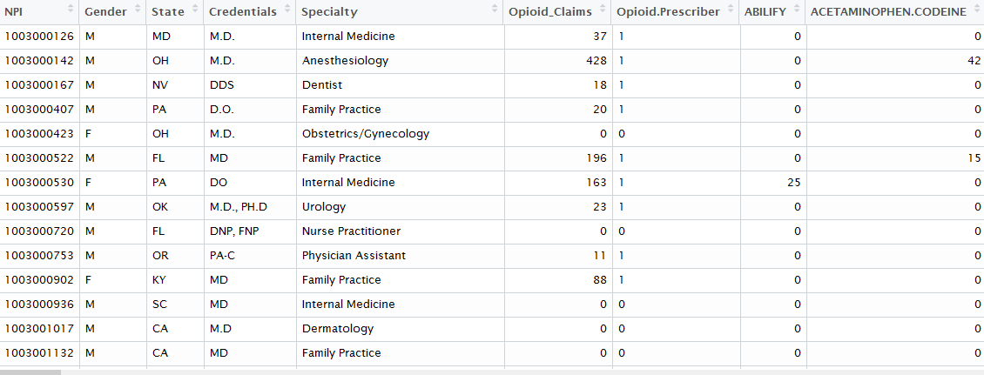
Data Cleaning
Libraries used:
Dplyr, tidyr, rvest, amelia
Formatting:
Prescriber data normalized to one NPI id per row
Each drug prescribed is now a column for each NPI
Most commonly prescribed 250 / 2500 drugs are selected
Match with Opioid drugs to create a binary target label
Cleaning:
Incorrect number of states and abbreviations
Handling missing gender, doctor specialty and NA values in claims
Removal of prescribed opioid drugs from data set as it makes prediction obvious
Assigning correct column types

Slide 5
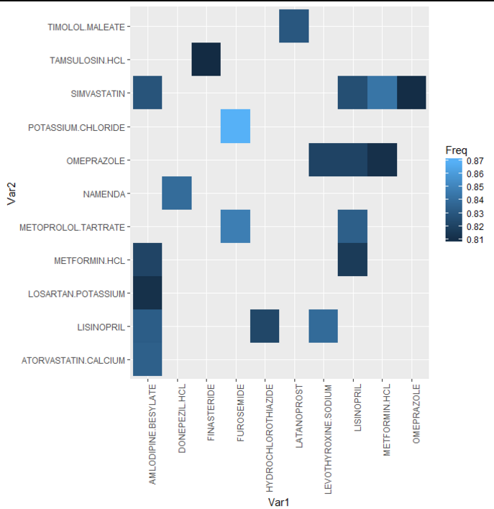
Data Analysis
Correlation :
Correlation between drugs when Opioid is prescribed
Top 20 correlations are plotted
Dot indicates compound drugs
High value for Furosemide - potassium.chloride
High value Furosemide - Metoprolol.tartate
Above drugs are highly used for congestive heart failures

Slide 6
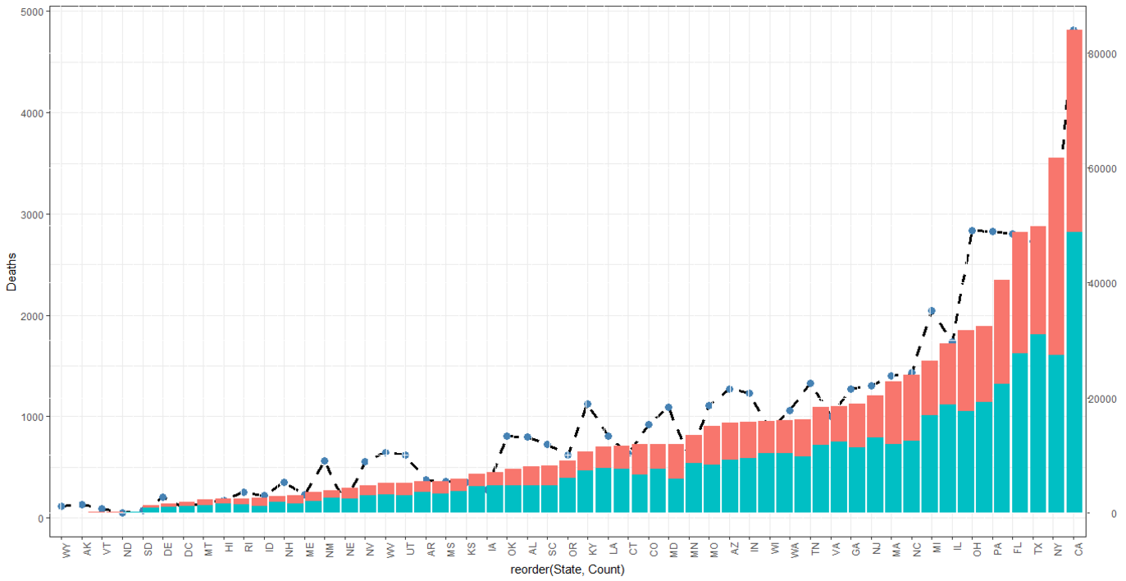
Data Analysis
Bar Plot :
Plot between opioid/non-opioid prescribers per state
Line plot indicates opioid related deaths
CA, NY have higher opioid prescriptions as well as deaths.

Slide 7
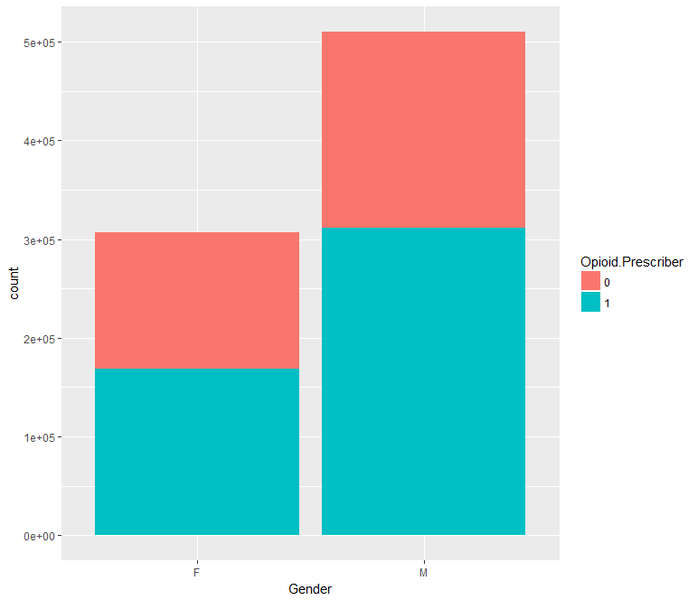
Data Analysis
Bar Plot :
Plot describes the relationship between Doctors prescribing opioid drugs and non-opioid drugs based on their gender.
It can be seen that percentage of male opioid prescribers is higher than female prescribers.

Slide 8
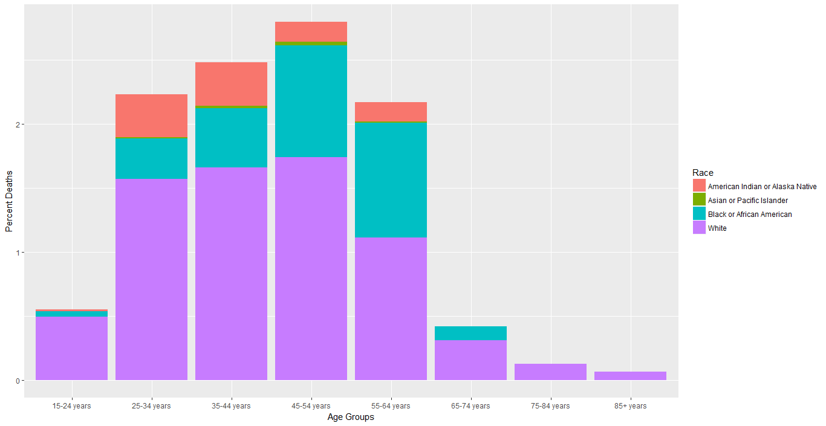
Data Analysis
Bar Plot : The graphs plots opioid deaths across age group and is filled based on the race.

Slide 9
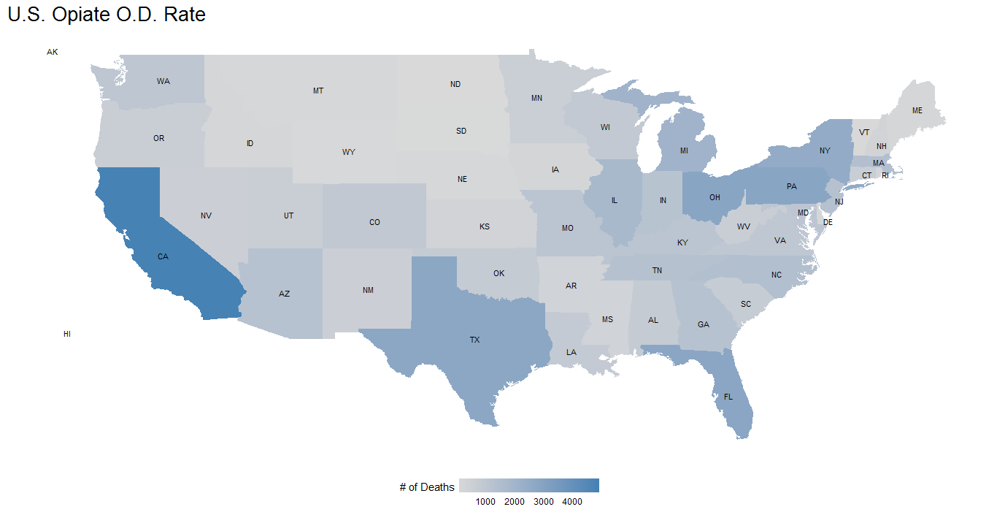
Data Analysis
Map describing deaths across states.
There is a noticeable pattern of higher deaths near the boundary states.

Slide 10
Modelling
Transforming data prior to modelling
Scoring categorical variables :
Data set contains important factor variables which is likely to contribute to predictions
Gender, State, Specialty of doctors are the identified as important columns
250 columns are numeric
One-hot encoding:
Categorical columns are binary encoded using dummies library
Model matrix loses the advantages of a data frame so it was avoided.
Final data set after encoding consists of 496 columns

Slide 11
Modelling
Performance tuning and results:
Random Forest :
Cross validation using caret train control and grid tuning
High Accuracy
Feature importance
Logistic Regression:
Cross validation using caret train control
Ease of understanding
Lasso GLM:
Identify important features
Cross validate using glmnet to find optimum lambda
Downside is high cross validation training time

Slide 12
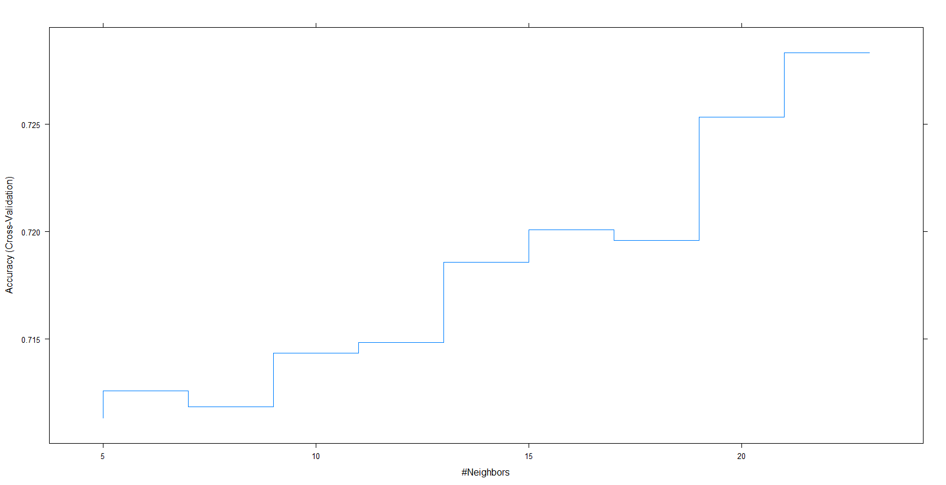
Modelling
Performance tuning and results:
K nearest neighbour:
Cross validated using caret train control
Scaled using caret pre-Process
Best performed at K=23
Naïve Bayes:
Easy to understand
Doesn’t take correlated drug columns into account
Used default parameters without laplace smoothing
Downside was it performed very poorly
Stochastic Gradient Boosting:
Blazing fast training time.
By far the best performing model.

Slide 13
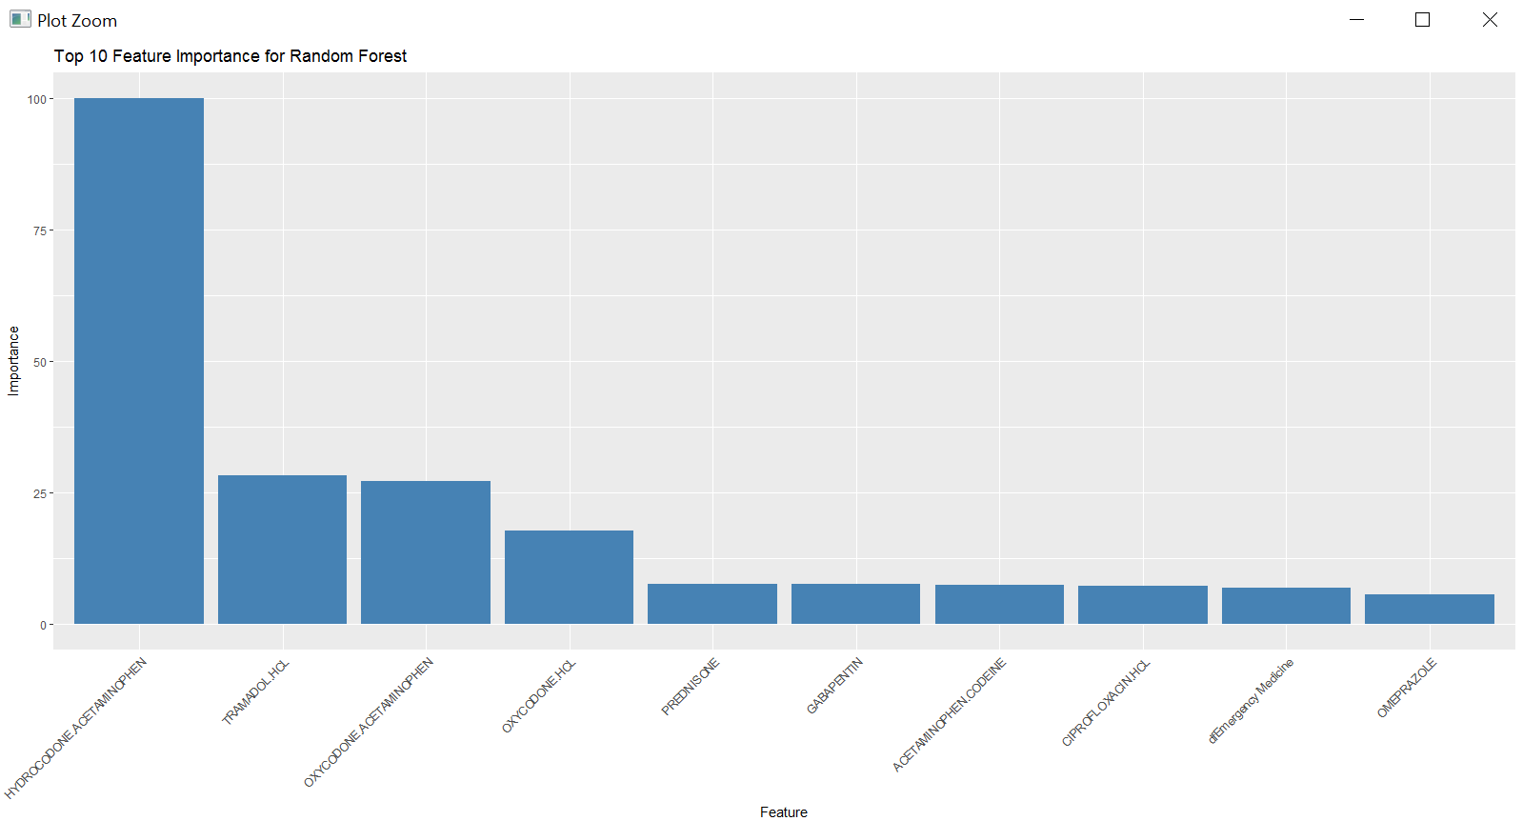
Modelling
Feature Importance:
Shows important columns identified by random forest.
Differs slightly from feature importance by other models.
Instead of individual drugs, compounds looks more in action.
Acetamenophen and HCL are identified to be the compounded drugs contributing more.
Other models do identify few specialties and states as the most important feature.

Slide 14
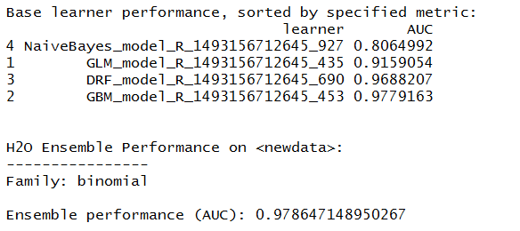
Modelling
Ensemble Technique:
H2o package is used for stacking.
Performance tuned parameters from standalone models are used in stacking instead of cross validating again.
Base model wrappers are created for each models and parameters
Meta learner used is logistic regression
Base models are passed as a list to stack on meta learner.
Model performance measured was better than standalone models.

Slide 15
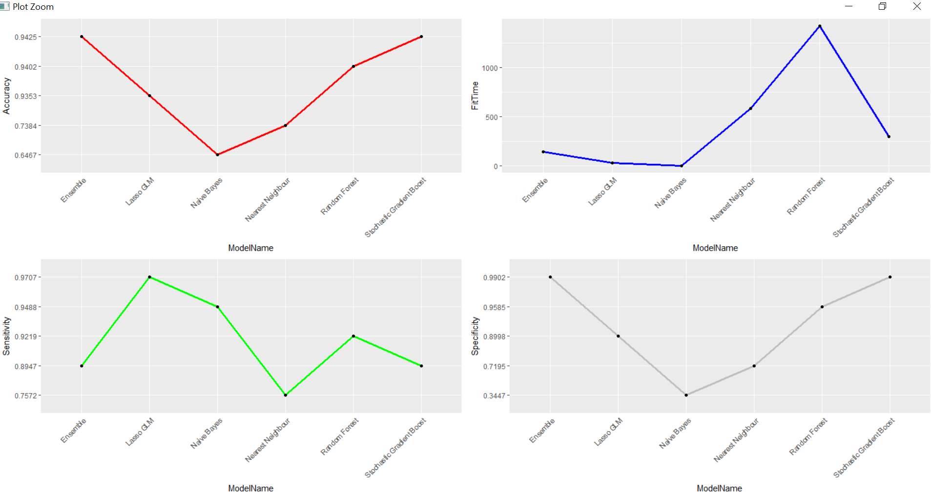
Model Performance
The figure shows comparative model performance of base models and ensemble.
Considering the accuracy and model fit time, ensemble and stochastic gradient boost is a winner.

Slide 16
Issues
Data Set:
Features and the data size along with hardware limitations increased the runtime to days.
Data set required a lot of cleaning to bring it to a suitable format.
Merging and Data validation was cumbersome.
Cross validation time on some models was very high even with 5 folds and no repeats.
Memory issues.
Collinearity:
Due to presence of feature “opioid_claims/refills” all models gave 100% accuracy. More investigation is needed.
The model performed realistically after removing the column.

Slide 17
Summary
The consumption of opioids is higher amongst white race across all age groups.
Compounded drugs are to be watched out for.
Male doctors are more inclined to prescribing opiates.
The boundary states looks more prone to opioid overdose deaths.
The ensemble model is good predictor of opioid prescriptions with 94.4% accuracy and AUC 97.2%. Stochastic gradient boost works best as a base model.

Slide 18

Next Steps
High number of refills must be related to higher overdose deaths as well as addictions. But this could not be linked to the demographic data. Further investigation is needed.
There is a relation between opioid deaths and the prescriber’s speciality. Some of the selected specialities are counter intuitive. Domain knowledge will be helpful.
Model performance can be further improved. Zero variance columns could have been removed beforehand and sub-setting to top 250 drugs could have been expanded.

Slide 19
Thank You

